Slide 1

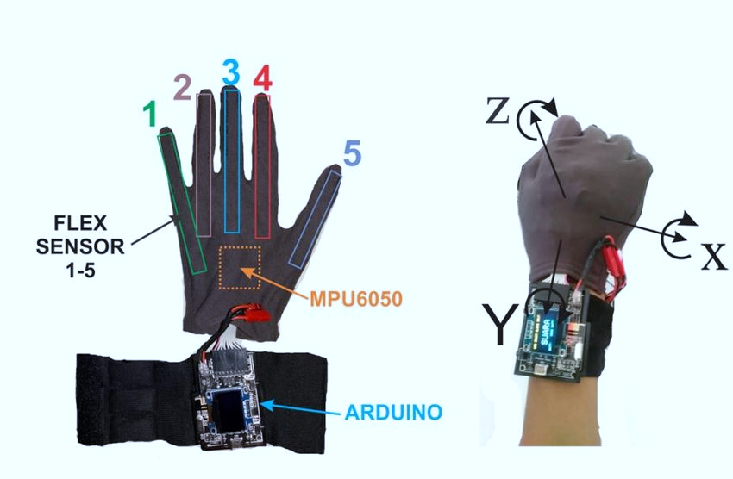
SMART GLOVE
Introduction:
Smart glove is a type of wearable technology that convert hand gestures to electrical signals which can be sent to a micro-controller that converts the signals into alphabets or commands.
The intention behind proposing this project is to help the hearing and speech impaired children learn and communicate normally by means of sign-language.
Advantages:
Increased accessibility: The gloves provide a new way for deaf individuals to access information and communicate with others, improving their overall quality of life.
Enhanced social interactions: By improving communication, the gloves can help facilitate social interactions and relationships between deaf and hearing individuals.
Minimal training required: Unlike learning sign language, which can take a long time and require substantial effort, the gloves are relatively easy to use, requiring minimal training.
Application:
Translation of sign language into text or speech: The gloves can detect the hand gestures used in sign language and translate them into spoken or written language, allowing for easier communication between the deaf and hearing communities.
Improving communication in noisy environments: By translating sign language into text or speech, the gloves can help deaf individuals communicate more effectively in noisy environments where it may be difficult to see the signs being made.
Enhancing education for deaf students: By providing a tool for more effective communication, the gloves can help deaf students to better participate in the classroom and understand lessons.

